Slide 1
OneClick
Overview & Demo

Slide 2
OneClick
Original and New
New One Click Flow
New Build Flow Verification
New Execute Flow Verification
Demo

Slide 3
What happen in Original OneClick !?
Problem
Do not update test result to ZION in section 01_PackageVerification.
็Full storage problem.
Can’t specific log destination path.
More requirements
Need to processing build on local machine instead of on telnet.
Need to manage log files to be new structure.
Need to collect logs history.

Slide 4
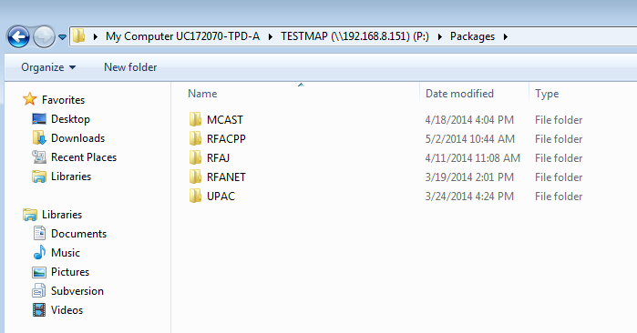
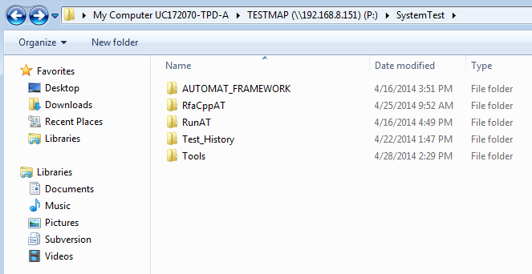
What’s news ?
Mapdrive to share all packages and scripts.
New structure of packages, scripts and log files.
Renovate Build Script to processing without telnet.
Have log historical directory.

Slide 5
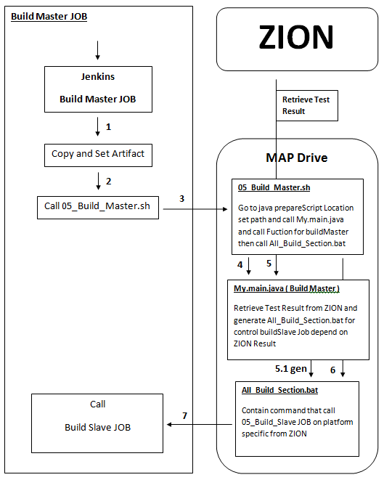
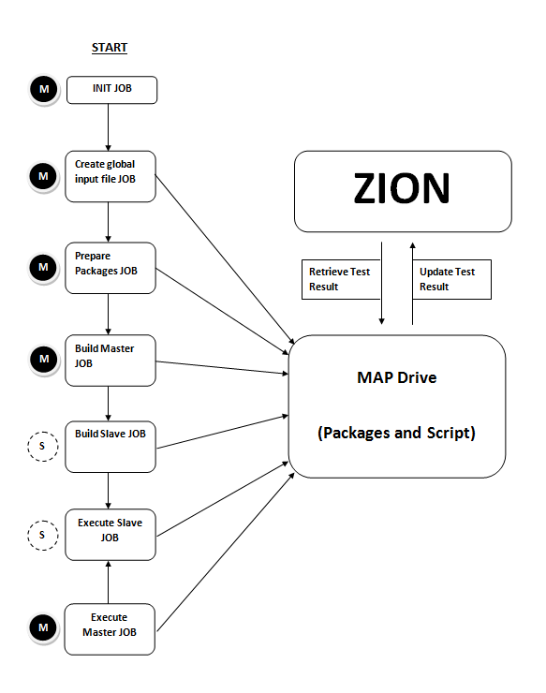
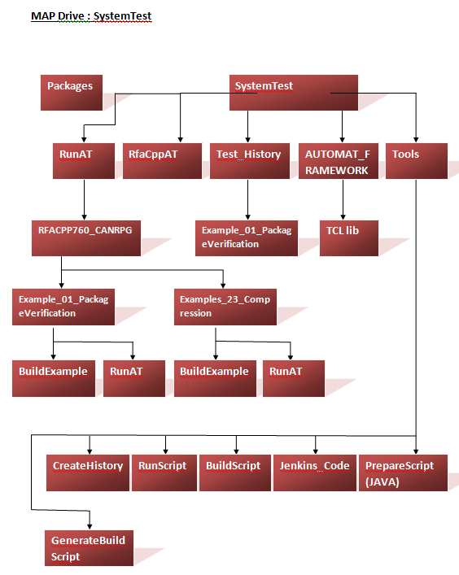
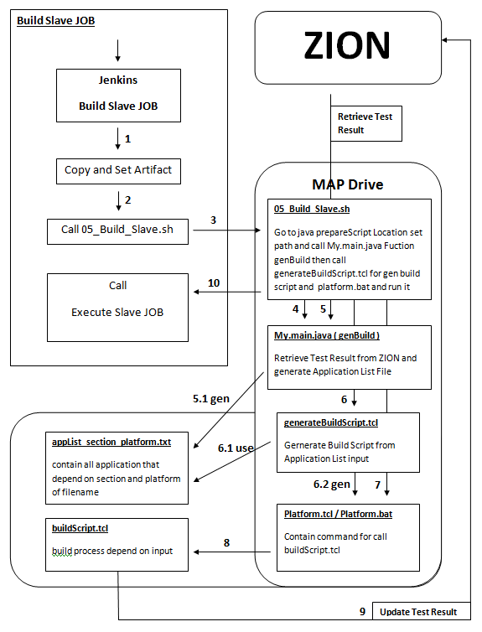
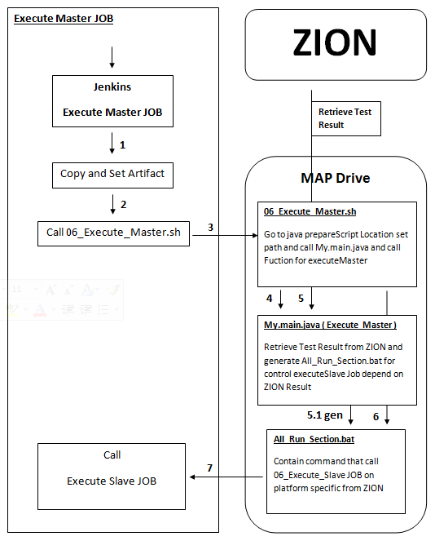
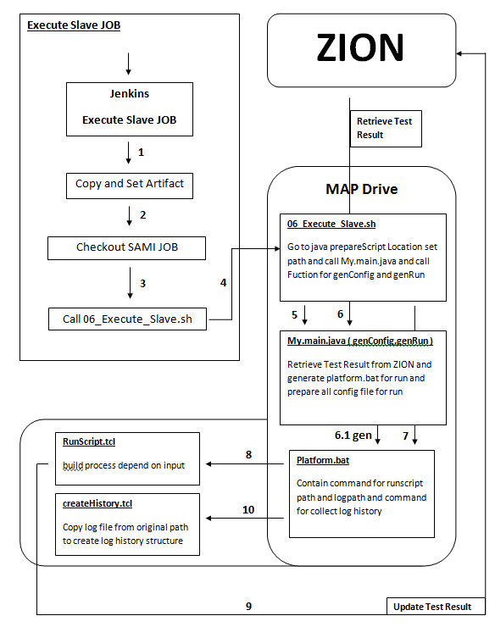
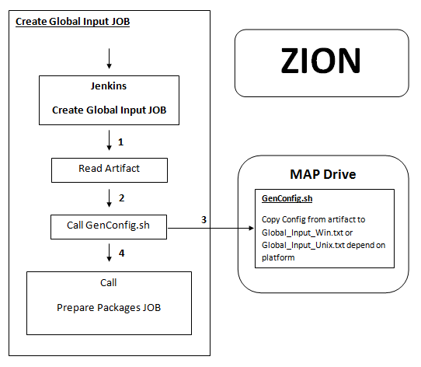
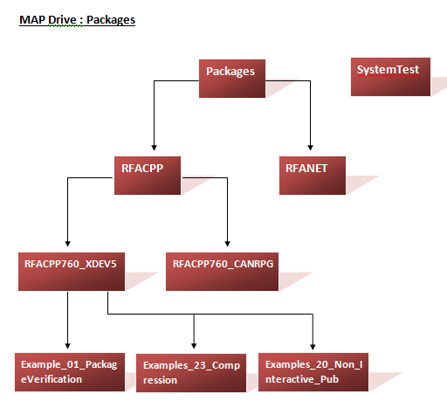
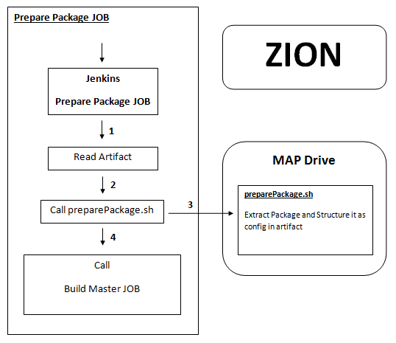
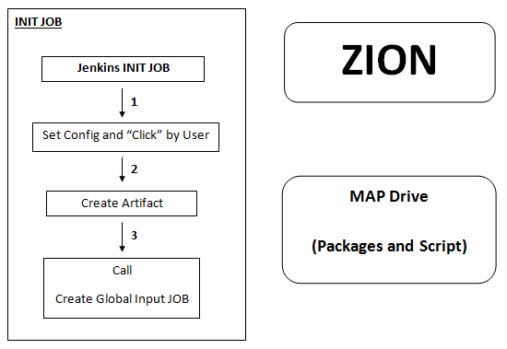

Slide 6
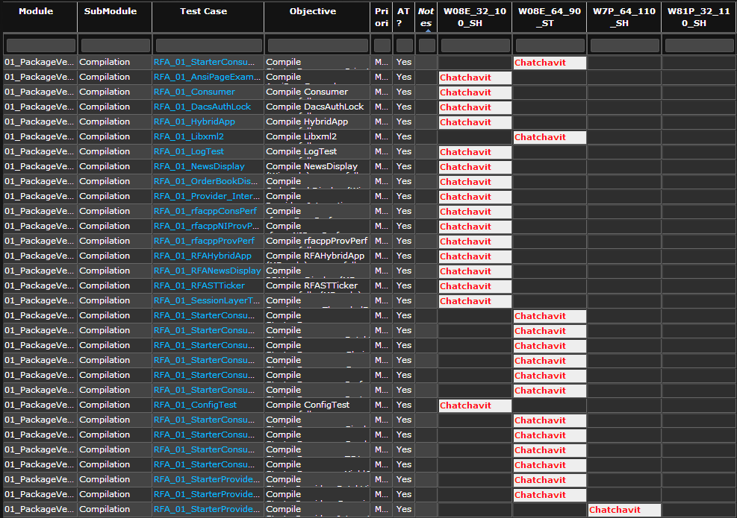
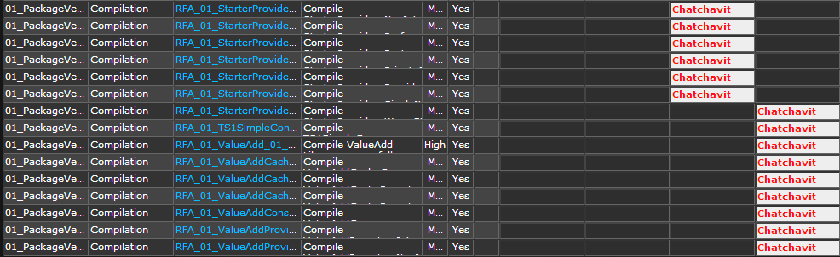
Build Flow Verification
AT Section “01_PackageVerification”
Platforms
W08E-32 (M45)
W08E-64 (M46)
W81P-32 (M33)
W7P-64 (M36)

Slide 7
Build Flow Verification AT Section “01_PackageVerification”
Machine/Test | Pure Mapdrive | Pure Local | Package on Local & Script on Mapdrive
W08E_32 [45] | 44.6 Minutes | 8.61 Minutes | 8.09 Minutes
W08E_64 [46] | 42 Minutes | 7.56 Minutes | 7.18 Minutes
W18P_32 [33] | 13 Minutes | 3.09 Minutes | 3.05 Minutes
W7P_64 [36] | 16.6 Minutes | 4.72 Minutes | 4.48 Minutes

Slide 8
Thankyou Q & A

